Slide 1
CPC Meeting #3
Competitive Programming Club

Slide 2
ICPC Contest Update
North America Championship Aug 8, 2021
World Finals Oct 1-6, 2021
https://icpc.global/regionals/upcoming

Slide 3
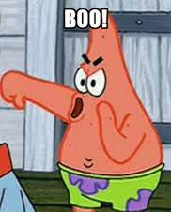
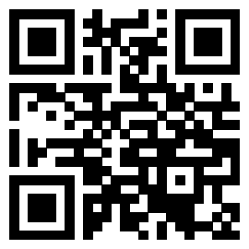

Calling all graphic designers
Submit Deadline: Sunday 10/17/2021 at midnight
Voting Meeting: Wednesday 10/20/2021 at 6pm
https://go.osu.edu/cpclogoform

Slide 4
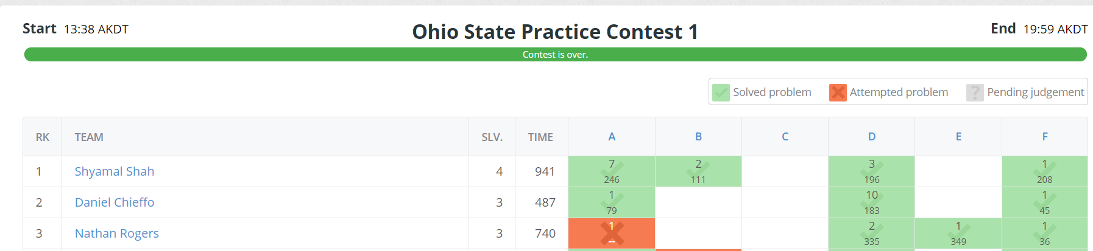
Contest Results
First to Solves
Problem | Participant
A | Tyler Hagerman
B | Shyamal Shah
C
D | Team Banana Bread
E | Nathan Rogers
F | Michael Appugliese
https://open.kattis.com/contests/h8exz4/standings
https://go.osu.edu/cpckattis

Slide 5
Problem F: Ostgotska
One line input of space separated words, find if the sentence is in Ostgotska
Note: 15 letters in their alphabet, words are separated by spaces
Print “dae ae ju traeligt va” if yes, else print “haer talar vi rikssvenska”

Slide 6
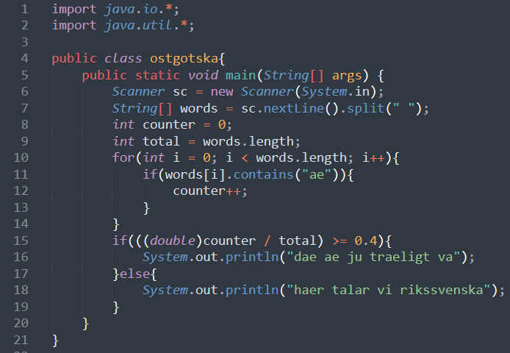
Java Solution

Slide 7
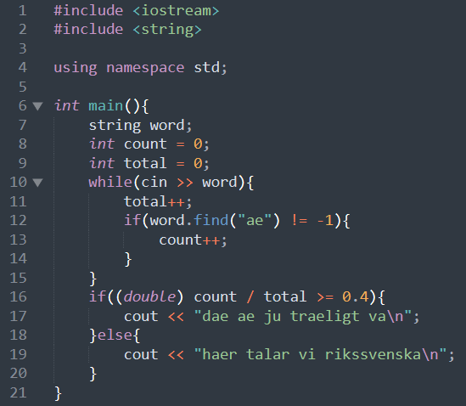
C++ Solution

Slide 8
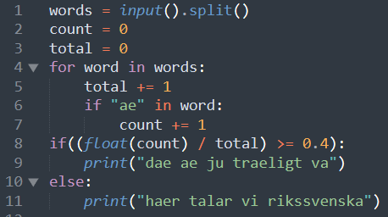
Python Solution

Slide 9
Solutions from yall
https://go.osu.edu/cpckattis

Slide 10
Kattis QnA
Kattis Help tab has tutorials and supported languages
Submit with extension, .py .cpp .java .c
Submission Status
Accepted (AC)
Wrong Answer (WA)
Compile Error (CE)
Time Limit Exceeded (TLE)
Run Time Error (RTE)
Memory Limit Exceeded (MLE)

Slide 11
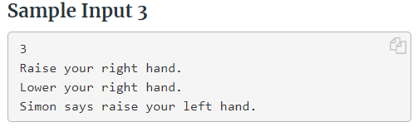
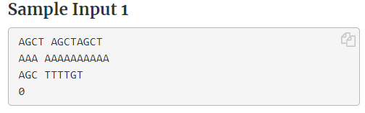
How to take in input
for(n times){
Take in input from each line
}
----------------------------------------------
while(next != 0){
Take in input from each line
}

Slide 12
Kattis Time
Finally!

Slide 13
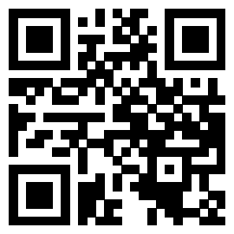
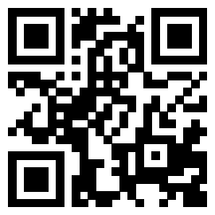
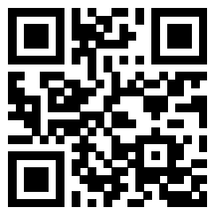
Discord
go.osu.edu/cpcdiscord
discord.gg/WmPGNRV
Kattis Contest Link
go.osu.edu/cpckattisnew
GroupMe
go.osu.edu/cpcgroupme
Attendance Form
go.osu.edu/cpcattendanceform
Notes:
1.3 to 4.7

